Slide 1
Research Unit
Vocabulary

Slide 2
Essential Question
What vocabulary do I need to learn to better understand how to research, properly read information, and utilize MLA format?

Slide 3
research
(v) to search or search for again

Slide 4
direct quote
(v) to take an author's words and repeat (a passage, phrase, etc.) from a book, speech, etc.

Slide 5
in-text citation
(n) In MLA format, this is a reference to the works of others in your text. This method involves placing relevant source information in parentheses after a quote or a paraphrase.
For example: (OWL 1).

Slide 6
MLA Format
MLA Format establishes standards of written communication concerning:
formatting and page layout
stylistic technicalities (e.g. abbreviations, footnotes, quotations)
citing sources
and preparing a manuscript for publication in certain disciplines

Slide 7
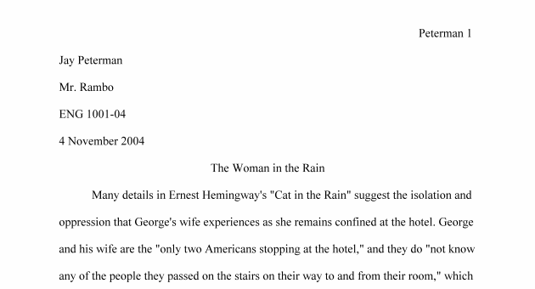
heading
(n) The top of the left side of the page that includes the student's name, teacher's name, class, date (day/month/year).

Slide 8
page citation
(n) On the right side of the page, the student's last name and page number is denoted.

Slide 9
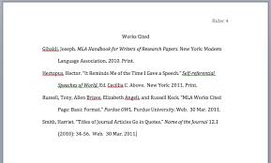
works cited
(n) A listing of entries that correspond to the works utilized in the in-text citations throughout your essay.

Slide 10
paraphrase
(n)The act or process of restating or rewording.

Slide 11
plagiarism
(n)A piece of writing or other work reflecting such unauthorized use or imitation.

Slide 12
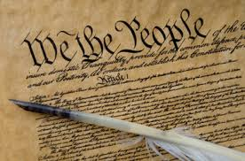
primary source
(n) Primary sources are original materials that have not been altered or distorted in any way. In the study of history as an academic discipline, a primary source (also called original source or evidence) is an artifact, a document, a recording, or other source of information that was created at the time under study.

Slide 13
secondary source
(n) Secondary sources are documents written after an event has occurred, providing secondhand accounts of that event, person, or topic. Unlike primary sources, which provide first-hand accounts, secondary sources offer different perspectives, analysis, and conclusions of those accounts.

Slide 14
informational texts
(n) Informational text is a type of nonfiction—a very important type. Nonfiction includes any text that is factual.

Slide 15
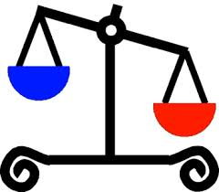
biased
(n)Unreasonably hostile feelings or opinions about a social group; prejudice.

Slide 16
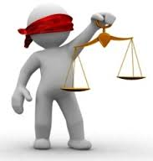
unbiased
(adj.) To not be biased or prejudiced; fair; impartial.

Slide 17
reliable
(adj)Information that may be depended for accuracy, honesty, etc.

Slide 18
unreliable
(adj)Information that may not be depended for accuracy, honesty, etc.

